Slide 1
Best Practices in Online Teaching
by
Linda Lyle

Slide 2
Learning Outcomes
As part of this training session, you will
Give an example of an item to be included in the “Expectations” page.
Participate in the class discussion by sharing ideas and opinions related to “Best Practices in Online Teaching.”
Identify one technique that you may incorporate in your online or hybrid course the next time you teach it.

Slide 4
Classroom Setting
Eye Contact
Body Language
Asking Questions
Responding to Questions
Use of Humor
Complimenting
Agreeing
http://www.freedigitalphotos.net

Slide 5
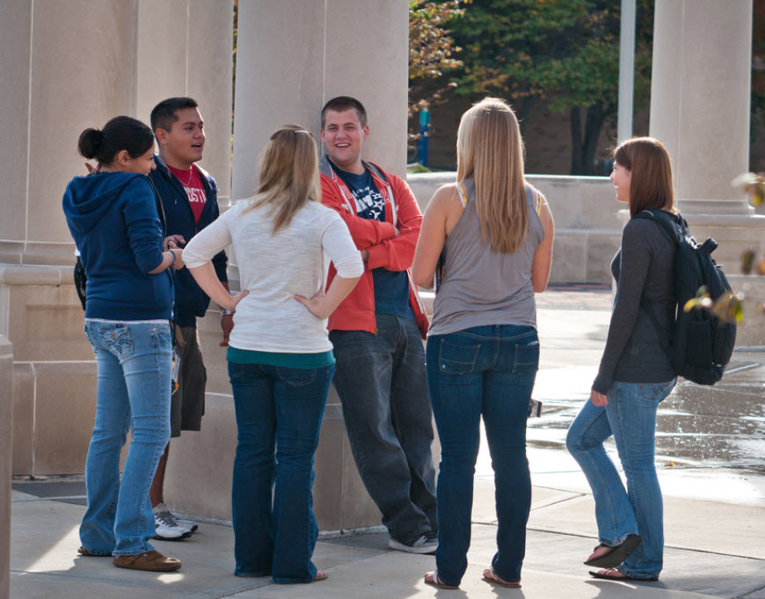
Best Practices: Social Presence (Community)
Flicker.com

Slide 6
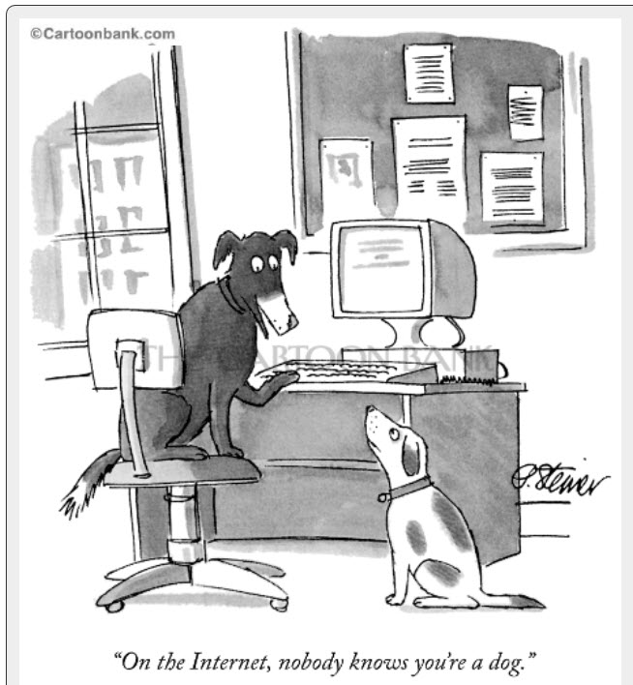
What’s Missing in the Online Environment?
Social Presence: The relationship that makes students feel like individuals.
Teacher Presence: How an instructor facilitates the learning activities and feedback to support and help learners achieve learning outcomes.

Slide 7
Best Practices
Many of the best practices have to do with course design. Even though we will discuss some of these topics, similar content may already be in our courses.
Tell Students How to Get Started
Ask Students to Introduce Themselves
Create a Set of Expectations
Prepare Engaging Content
Prepare Discussion Posts
Create Assignments that Support Learning Outcomes

Slide 8
Be Present in the Course
Notes:
(Teacher Presence)
An online class doesn’t “teach itself.”
Post your own personal welcome letter before the first day of class either in the News area, Email, or Discussion.
Professional experiences
Personal Information (family, pets, hobbies)
Photo (if wanted)
Audio or video introduction
Enter the course every day if at all possible. Include in the expectations page information about when students should expect you to communicate and tell them you will notify them if the schedule cannot be kept.
NSCC Guideline: Answer emails daily Monday through Friday. It is highly recommended that faculty answer emails 7 days a week. Notify students if you are unable to keep the schedule.
Tell students of turnaround time for grading assignments and discussions and provide effective feedback.
This means liberal use of the communication tools – disc, etc. – that communicates to the student that the teacher cares.
Being available daily –emailing and any other communication.

Slide 9
Be Present in the Course Dr. Beth Klingner http://youtu.be/7xzFuOT2VWM

Slide 10
Introductions: What to Include https://www.youtube.com/watch?v=GLHQropMhcg

Slide 11
Introductions: Faculty Self-Introduction https://www.youtube.com/watch?v=7VHt9d3eZk8

Slide 12
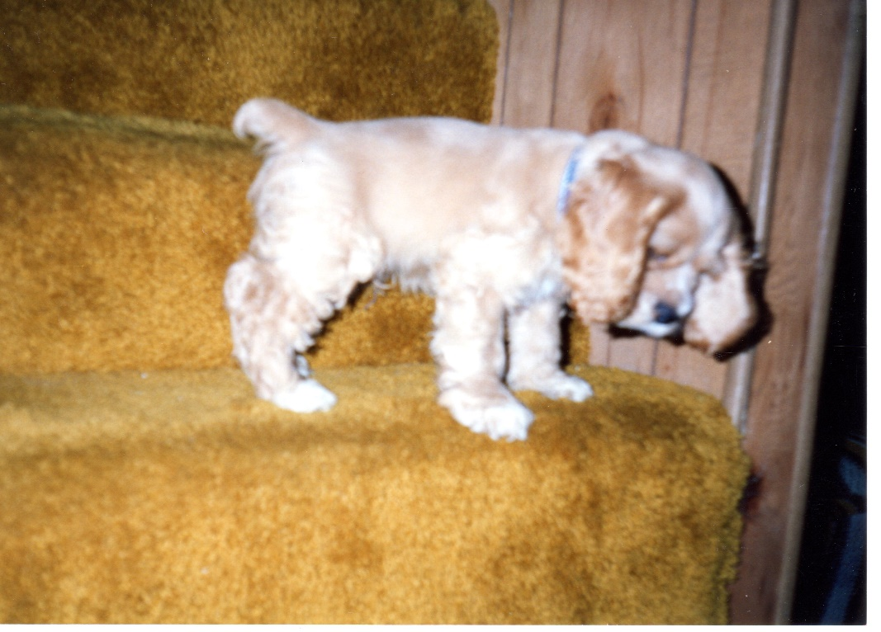
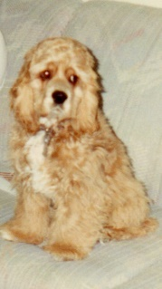
Show Your Personality
Learning to go down steps--

Slide 13
Sample Welcome Letter
Hello Mary,
Welcome to my class! I realize that you may be feeling a bit apprehensive and not sure of what to expect in this course. Each week I will send out a unit overview that will help orient you to the week’s activities. Please be sure to review it each week, so you know what to do. I also will describe any areas where past learners have had problems in order to keep you from having the same problem. Please know that I am here to support you, so please do not hesitate to ask me questions and let me know what I can do to support you. Now relax and enjoy the course.
(Name)
Stavredes, Tina. Effective Online Teaching: Foundations and Strategies for Student Success. San Francisco, CA: Jossey-Bass, 2011. 70.

Slide 14
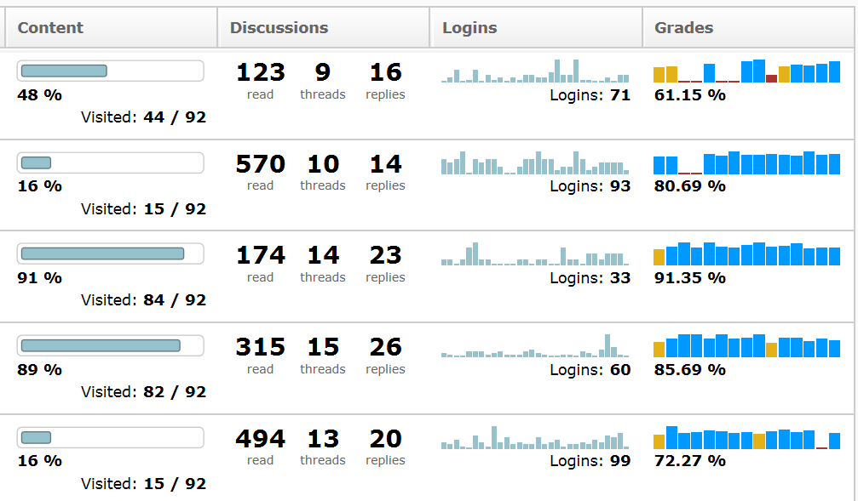
Progress Report
Checklist
Dropbox
Quizzes
Surveys

Slide 15
Late Work Email Example
Hi John,
We have finished the activities for Unit 3 and it appears that you were not able to participate in the activities for this unit. There were two graded activities, the Unit 3 Discussion on the use of deception in research and the Unit 3 Assignment, which is a draft of issue paper.
I will accept your initial post to the discussion question and the draft of your paper through midnight, Wednesday, September 15, 2010. If you do not turn them in by that date and you do not communicate with me regarding your ability to make that deadline, your grade for these activities will become 0 and you will not have another opportunity to make up the grades.
Please let me know how you are doing and if there are any issues or concerns that you are having that are keeping you from actively engaging in the course. I am here to support you.
(Instructor)
Stavredes, Tina. Effective Online Teaching: Foundations and Strategies for Student Success. San Francisco, CA: Jossey-Bass, 2011. 194.
Notes:
Proactive Communication:
Define the issue: nonparticipation, failing grades, writing issues, technology issues.
Describe the issue in detail, including any solution strategies that you have previously recommended.
Define Actions needed: Describe what actions need to be taken by the learner to overcome the issues.
Include a specific time time for resolving the issue
Describe what will happen if appropriate actions are taken the what will happen if appropriate actions are not taken.
Include your name on the email.

Slide 16
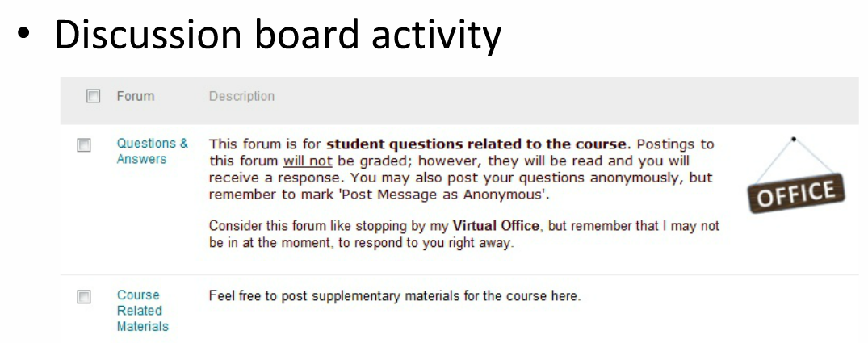
Faculty Presence
Cory, Rebecca C., Ph.D, Associate Professor, City of Seattle, May 20, 2014. Webinar.
https://cityu.adobeconnect.com/p3uzs49pd6t/?launcher=false&fcsContent=true&pbMode=normal

Slide 17
List of Ideas for Creating a Presence
Create Presence?

Slide 18
Provide a Clear Set of Expectations
Notes:
For Yourself and For Your Students
Personal choice—reflects philosophy. Amount of support depends on the maturity of the learners and instructor’s time.
The challenge is to find the level of support that is needed for a particular group of students, the number of students, and the type of course.
Send reminders to students more often in the beginning with the goal of helping them take responsibility for managing their own learning.

Slide 19
Let’s Use Socrative
Go to m.socrative.com.
Enter 541204
Along the way, I’ll be asking you some questions.
http://t.socrative.com

Slide 20
Socrative Question 1
List one expectation to include in "Expectations for this Course."
http://t.socrative.com

Slide 21
Provide a Set of Expectations http://youtu.be/A6c8EYl-OK4?t=1h30m20s (Begin at 1:30:00)

Slide 22
Course Expectations
This document usually outlines the expectations for the student and instructor and may repeat information that is found in the syllabus. The expectations may include:
A statement about teaching style
Types of interactions students should expect from the instructor
A statement about how to contact the instructor
Expectations about when discussions and assignments will be returned
Expectations about when emails will be answered. For example, “Emails will be answered within 24 hours daily Monday through Friday and within 48 hours on weekends.”
A description of the pace of the course
Instructions about whether or not to work ahead
A description of the organization of the course
An estimate of the number of hours a student should spend on the course each week
A list of required course materials

Slide 23
Course Orientation
Complete the following activities to ensure you understand what course room tools will be used and where they are located so you can access them when needed.
Each week begin with the Content for the assigned Module. Click on the Table of Contents and review the modules that have been created for this course.
Navigate to the discussion board and locate the first topic, “Introduce Yourself.” Later you will be posting an introduction to me and your classmates.
Navigate to the assignment box and review the assignments for the course and their due dates.
Go to email and read my welcome message. Send me a reply so I know that you know how to reply to email messages.
Go to the grade book and view the outline of items to be graded. This is where I will post your grades.
Review the syllabus, expectations document, schedule of due dates, etc., etc. etc.

Slide 24
Video Example for Course Orientation https://www.youtube.com/watch?v=X0f_GU9cnDk&list=PLAzzv1Ff1A5wi50P3aLxHznD42ATZBGGx

Slide 25
List of Ideas for Clear Expectations
Clear Expectations?
Notes:
For Yourself and For Your Students
Personal choice—reflects philosophy. Amount of support depends on the maturity of the learners and instructor’s time.
The challenge is to find the level of support that is needed for a particular group of students, the number of students, and the type of course.
Send reminders to students more often in the beginning with the goal of helping them take responsibility for managing their own learning.

Slide 26
Build an Online Course Community
Notes:
(Social Presence)
Create teacher-to-student, student-to-student, and student to content interactions.
Start class with an introduction of teacher and student, place for students to request help, group work,
Some believe we learn as social beings.

Slide 27
Community http://youtu.be/Qb9M0B_Pus4 Alvin Allert

Slide 28
Socrative Question 2
List one way to build an online community in your course.

Slide 29
List of Ideas for Building an Online Course Community
Build Online Community?
Notes:
(Social Presence)
Create teacher-to-student, student-to-student, and student to content interactions.
Start class with an introduction of teacher and student, place for students to request help, group work,
Some believe we learn as social beings.

Slide 30
Ask Early for Feedback

Slide 31
Ask Early for Feedback
Early Feedback?

Slide 32
Build Community, Critical Thinking, and Interaction with Discussions
Notes:
Clear Set of Expectations. (Maybe include list here)

Slide 33
List of Ideas for Using Discussions
Discussions and Community Building?

Slide 34
Discussion Board Reflection
Write a reflection on your participation in the Discussion Board this semester:
Did you contribute to the online community through the Discussion Board?
What course content addressed in the Discussion Board did you learn or change your mind about over the semester?
What questions do you still have related to the course?
Were you a supportive classmate? Describe how you support your answer.
What could be done to improve the Discussion Board experience?
Portions adapted from Cory, Rebecca C., Ph.D, Associate Professor, City of Seattle, May 20, 2014. Quoting from Haley Lake at EWU. Webinar.
https://cityu.adobeconnect.com/p3uzs49pd6t/?launcher=false&fcsContent=true&pbMode=normal

Slide 35
Provide Timely and Effective Feedback

Slide 36
Provide Effective and Timely Feedback http://youtu.be/QxSoa3RRoVo?t=6m30s Andrew Campbell (Start at 6:30)

Slide 37
List of Ideas for Providing Timely Feedback
Timely Feedback?

Slide 38
Wrap up the Course
Notes:
Remind students the class is about to come to a close.

Slide 39
Wrap Up http://youtu.be/QxSoa3RRoVo?t=9m6s Andrew Campbell (Start at 9:06)

Slide 40
Socrative Question 3
List one thing you can do to effectively wrap up a course.

Slide 41
Ideas for Wrapping Up a Course
Wrap Up a Course?

Slide 42
Deal with Conflict Promptly
This topic will be presented as a separate in-service session.

Slide 43
Techniques You Might Try

Slide 44
Socrative Question 4
List one technique we discussed today that you may implement the next time you teach an online course?

Slide 45
Resources
Boettcher, J. V. Designing for Learning, Ten Best Practices for Teaching Online . Retrieved May 2014 from http://www.designingforlearning.info/services/writing/ecoach/tenbest.html
Ragan, Lawrence C. (2005) 10 Principles of Effective Online Teaching: Best Practices in Distance Education. Distance Education Report. Retrieved May 2014 from http://www.mnsu.edu/cetl/teachingwithtechnology/tech_resources_pdf/Ten%20Principles%20of%20Effective%20Online%20Teaching.pdf
Reis, Rick. Ten Best Practices for Teaching Online. Retrieved May 2014 from http://cgi.stanford.edu/~dept-ctl/tomprof/posting.php?ID=1091
Stavredes, Tina. (2011) Effective Online Teaching: Foundations and Strategies for Student Success. San Francisco, CA: Jossey-Bass. pp. 70-196.

Slide 46
Thank you for attending.
Have a great semester!

