Slide 1
Review of the Accounting Process
Intermediate Accounting I
Chapter 2
This presentation is under development.

Slide 2
The Accounting Cycle
The steps in the accounting process covered in a fiscal period.
Analyze and record business transactions
Post transactions to the ledger
Prepare a trial balance
Record & post adjusting entries
Prepare an adjusted trial balance
Prepare the financial statements
Journalize & post the closing entries
Prepare a post-closing trial balance

Slide 3
Review of Accounting “Building Blocks”
Accounting information is built using five basic account categories.
Assets
Liabilities
Equity
Revenue
Expenses
Accounts may further be classified as contra (deduction) or adjunct (addition).
Fundamental Accounting Equation: Assets = Liabilities + Equity
Accounts are increased or decreased with a Debit (DR) or Credit (CR).
Assets, expenses and dividends increase with debits and decrease with credits.
Liabilities, revenue, and equity increase with credits and decrease with debits.

Slide 4
Recording Business Transactions
A business transaction is an event that can be measured in dollars that affects the financial condition of a business. Business transactions are generally evidenced by source documents.
Daily business transactions are first recorded in a journal and then posted to the ledger. The normal balance of each ledger account is the increase side of that account.
Journal – a book used to record day-to-day business transactions in chronological order.
Ledger - an individual record of transactions affecting each account.

Slide 5
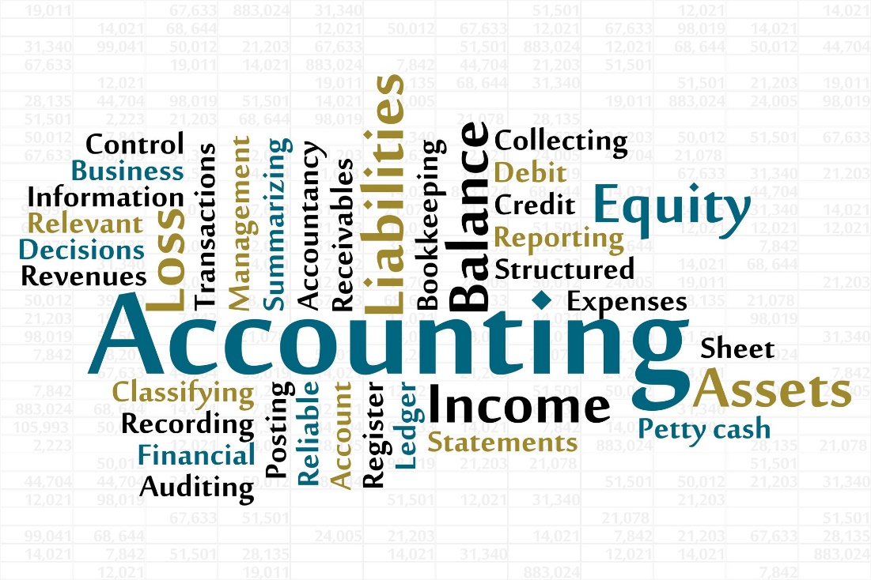
Journal Entries – Daily Transactions
ABC Company Transactions
Journalize the transactions on the following slides for ABC Company occurring during the month of July.

Slide 6
Journalizing Transactions
July 1 Issued 3,000 shares of common stock for $30,000.
July 3 Purchased $60,000 of clothing inventory on account from the Birdwell Wholesale Clothing Company.
July 6 Purchased $2,000 of supplies for cash.
Jul
1
Cash
30,000
Common Stock
30,000
3
Merchandise Inventory
60,000
Accounts Payable
60,000
6
Supplies
2,000
Cash
2,000

Slide 7
Journalizing Transactions
July 7 Sold merchandise costing $20,000 for $35,000 cash.
Jul
7
Cash
35,000
Sales
35,000
7
Cost of Goods Sold
20,000
Merchandise Inventory
20,000
This transaction could alternatively be recorded as a compound entry.
Jul 7 | Cash | 35,000
 | Cost of Goods Sold | 20,000
 | Sales |  | 35,000
 | Merchandise Inventory |  | 20,000

Slide 8
Journalizing Transactions
July 9 Sold clothing on account to St. Jude’s School for Girls for $3,500. The clothing cost $2,000.
July 20 Paid Birdwell Wholesale Clothing $25,000 on account.
Jul 9 | Accounts Receivable | 3,500
 | Sales |  | 3,500
9 | Cost of Goods Sold | 2,000
 | Merchandise Inventory |  | 2,000
20 | Accounts Payable | 25,000
 | Cash |  | 25,000

Slide 9
Journalizing Transactions
July 20 Paid salaries to employees for the first half of the month, $5,000.
July 25 Received $1,500 on account from St. Jude’s.
July 30 The corporation paid its shareholders a cash dividend of $1,000.
Jul 20 | Salaries Expense | 5,000
 | Cash |  | 5,000
25 | Cash | 1,500
 | Accounts Receivable |  | 1,500
30 | Retained Earnings | 1,000
 | Cash |  | 1,000

Slide 10
Posting Transactions
Information in the journal is transferred to individual ledger accounts through a process known as posting. A ledger is a individual record of each of a company’s accounts.
Transactions are posted automatically in computerized accounting systems.
The posting reference in the ledger refers back to the original journal entry.

Slide 11
Adjusting Entries
Adjustments are necessary to bring the balances of certain accounts up to date prior to preparing the financial statements at the end of the fiscal period.
Internal transactions
Non Cash
Impact both the balance sheet and income statement
Involve prepayments (deferrals), accruals, or estimates

Slide 12
Adjusting Entries - Prepayments
Prepayments, also called deferrals, are transactions in which the cash payment precedes recognition of the expense or revenue.
Prepaid expenses - represent assets recorded when a cash disbursement creates benefits beyond the current reporting period
Unearned revenues - represent liabilities recorded when cash is received from customers in advance of providing a good or service

Slide 13
Adjusting Entries - Prepayments
Sample Transactions Use the following information to record adjusting entries for the month of July 2017.
The ledger account for Supplies shows a balance of $2,000. A physical count of supplies reveals that $800 of supplies are on hand at the end of the fiscal period.
On July 1, the company paid $24,000 in advance for one year’s insurance on the store building.
Subleased a portion of the building to a jewelry store. Received $1,000 in advance for the first two months’ rent beginning on July 16.
1) | Supplies Expense | 1,200
 | Supplies |  | 1,200
 | (beginning balance $2,000 less ending balance $800 = $1,200 used)
2) | Insurance Expense | 2,000
 | Prepaid Insurance |  | 2,000
 | ($24,000/12 months = $2,000 per month)
3) | Unearned Rent Revenue | 250
 | Rent Revenue |  | 250
 | ($1,000/2 months = $500 per month X ½ month = $250)

Slide 14
Adjusting Entries - Accruals
Accruals are transactions in which cash is received or paid in a period subsequent to recognition of the expense or revenue.
Accrued liabilities - recorded when an expense has been incurred prior to cash payment.
Accrued receivables – recorded when revenue is earned in a period prior to the cash receipt.

Slide 15
Adjusting Entries - Accruals
Sample Transactions Use the following information to record adjusting entries for the month of July 2017.
Borrowed $30,000 from a local bank signing a promissory note requiring the payment of principal in two years. Interest at 10% is payable each year on July 1, 2017, and July 1, 2018.
On July 31, salaries of $5,500 had been earned by the company’s employees but would not be paid until Aug 3.
On July 1, the company invested $12,000 in a CD that accrues monthly interest at the rate of 4%. Interest is only posted annually, however.
1) | Interest Expense | 250
 | Interest Payable |  | 250
 | ($30,000 X 10% = annual interest of $3,000/12 months = $250 per month)
2) | Salaries Expense | 5,500
 | Salaries Payable |  | 5,500
3) | Interest Receivable | 40
 | Interest Income |  | 40
 | ($12,000 X 4% = annual interest of $480/12 months = $40 per month)

Slide 16
Adjusting Entries - Estimates
Estimates are sometimes required in order to adhere to the accrual basis of accounting and the matching principle.
Bad Debts Expense
Depreciation (could also be considered a deferral)

Slide 17
Trial Balance
A Trial Balance is prepared to ensure that the accounts are in balance prior to preparing the financial statements.
A simple working paper listing each account and its ending balance under the appropriate normal balance column.
Accounts with -0- balances may be omitted.
Prepared at the end of the fiscal period.
If the trial balance does not balance, the error must be found and corrected prior to proceeding with the end-of-period accounting tasks.
A trial balance prepared after recording and posting the adjusting entries is known as an Adjusted Trial Balance.

Slide 18
Financial Statements
At the end of the accounting period, financial statements are prepared and provided to the users of the financial information.
Income Statement
Statement of Shareholders’ Equity
Balance Sheet

Slide 19
Income Statement
The income statement lists revenues and expenses. For a retail organization, cost of goods sold is deducted from revenue to determine gross profit.
Expenses are often categorized by operating expenses and other expenses. Other income/expenses (primarily interest) are listed separately at the bottom of the statement.
CHARLEY’S COOKIE CORPORATION
Income Statement
For the Year Ended December 31, 2017
Sales revenue |  | $800,000
Cost of goods sold |  | 480,000
Gross profit |  | 320,000
Operating expenses:
Salaries | $120,000
Rent | 30,000
Depreciation | 60,000
Advertising | 5,000
Total operating expenses |  | 215,000
Operating income |  | 105,000
Other expense:
Interest |  | 4,000
Net income |  | $101,000

Slide 20
Statement Of Shareholders’ Equity
The statement of shareholders’ equity shows how the shareholders’ equity account has changed over a period of time. The ending balance in the Shareholders’ Equity account is computed and then reported on the balance sheet.

Slide 21
Balance Sheet
The balance sheet reports the ending balance of asset, liability, and equity accounts. A classified balance sheet breaks out assets and liabilities into current and non-current categories.
CHARLEY’S COOKIE CORPORATION
Balance Sheet
At December 31, 2017
Assets
Current assets:
Cash |  |  | $ 21,000
Accounts receivable |  |  | 350,000
Prepaid rent |  |  | 10,000
Total current assets |  |  | 381,000
Property and equipment:
Office equipment |  | $600,000
Less: Accumulated depreciation |  | (250,000) | 350,000
Total assets |  |  | $731,000
Liabilities and Shareholders' Equity
Current liabilities:
Accounts payable |  |  | $ 68,000
Interest payable Note payable |  |  | 2,000 60,000
Total current liabilities |  |  | 130,000
Shareholders’ equity:
Common stock | $400,000
Retained earnings | 201,000
Total shareholders’ equity |  |  | 601,000
Total liabilities and shareholders’ equity |  |  | $731,000

Slide 22
Closing Entries
At the end of the accounting period, all temporary (nominal) accounts are closed so that the accounts have a “zero” balance to begin the next fiscal period.
Revenues
Expenses
Income Summary
Dividends

Slide 23
Journalizing Closing Entries
Below is a partial adjusted trial balance for the fiscal year end of October 31. Prepare the appropriate closing entries.
Account Title | Debits | Credits
Retained earnings | 1,000
Sales revenue |  | 38,500
Rent revenue |  | 250
Cost of goods sold | 22,000
Salaries expense | 10,500
Depreciation expense | 200
31 | Sales Revenue | 38,500
 | Rent Revenue | 250
 | Income Summary |  | 38,750
31 | Income Summary | 32,700
 | Cost of Goods Sold |  | 22,000
 | Salaries Expense |  | 10,500
 | Depreciation Expense |  | 200
31 | Income Summary | 6,050
 | Retained Earnings |  | 6,050

Slide 24
Post-Closing Trial Balance
The last step in the accounting cycle is to prepare a Post-Closing Trial Balance.
Prepared after the closing entries have been journalized and posted.
Includes only remaining permanent accounts – assets, liabilities, equity.
If the trial balance does not balance, the error must be found and corrected prior to beginning the new accounting period.

Slide 25
Review of the Accounting Process
Intermediate Accounting I – Chapter 2
End of presentation

