Slide 1
Example of Amortization Schedule for a Note with Equal Total Payments
The following example is based on information from Exercise 14-14 in your textbook. This problem is assigned as Question 1 in Connect.

Slide 2
Problem Data:
On January 1, 2009, American Eagle borrows $90,000 cash by signing a four-year, 5% installment note. The note requires four equal total payments of accrued interest and principal on December 31 of each year from 2009 through 2012.
Requirements:
Compute the amount of each of the four equal total payments using the present value table B.3. Prepare an amortization schedule for the installment note.

Slide 3
Before proceeding, click below
for a printable copy of the
example so that you can work along with the presentation.
Print the Problem and Schedule (Allow blocked content to display.)

Slide 4
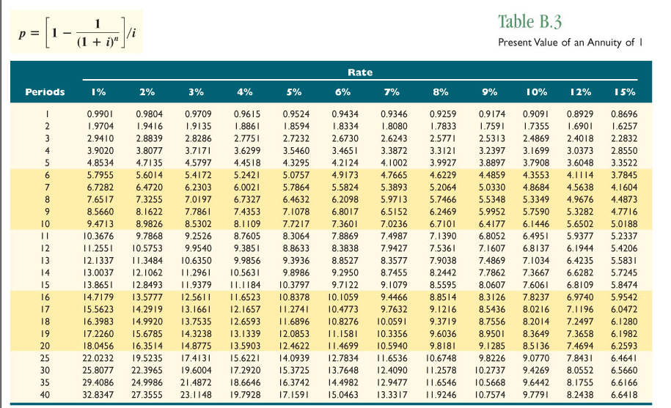
Compute the Equal Total Payments
Using Table B.3, find the present value factor for four years at 5% interest (from problem data) by reading across from the period and down from the rate.

Slide 5
Compute the Equal Total Payments
Using Table B.3, find the present value factor for four years at 9% interest (from problem data) by reading across from the period and down from the rate.

Slide 6
Compute the Equal Total Payments
Using Table B.3, find the present value factor for four years at 9% interest (from problem data) by reading across from the period and down from the rate.

Slide 7
Compute the Equal Total Payments
The note payment is computed by dividing the principal by the present value factor.
Principal: $90,000 / PV Factor: 3.5460 =
Payment: $25,381 (rounded to the nearest whole dollar)

Slide 8
Complete the Amortization Schedule

Slide 9
Complete the Amortization Schedule
Enter the principal in the Beginning Balance blank.
90,000

Slide 10
Complete the Amortization Schedule
Enter the principal in the Beginning Balance blank.
Calculate Interest Expense by multiplying the beginning balance by the interest rate stated on the note ($90,000 X .05)
90,000
4,500

Slide 11
Complete the Amortization Schedule
Enter the principal in the Beginning Balance blank.
Calculate Interest Expense by multiplying the beginning balance by the interest rate stated on the note ($90,000 X .05)
Enter the equal total payment amount in the Credit Cash blank (calculated in Slide 7.)
90,000
4,500
25,381

Slide 12
Complete the Amortization Schedule
Enter the principal in the Beginning Balance blank.
Calculate Interest Expense by multiplying the beginning balance by the interest rate stated on the note ($90,000 X .05)
Enter the equal total payment amount in the Credit Cash blank.
Determine the amount of principal reduction to be debited to Notes Payable by finding the difference between the cash payment and the amount charged to interest ($25,381 - $4,500).
90,000
4,500
20,881
25,381

Slide 13
Complete the Amortization Schedule
Enter the principal in the Beginning Balance blank.
Calculate Interest Expense by multiplying the beginning balance by the interest rate stated on the note ($90,000 X .05)
Enter the equal total payment amount in the Credit Cash blank.
Determine the amount of principal reduction to be debited to Notes Payable by finding the difference between the cash payment and the amount charged to interest ($25,381 - $4,500).
Calculate the Ending (principal) Balance as Beginning Balance less the principal reduction debited to Notes Payable ($90,000 - $20,881) and place the ending balance for this period in the Beginning Balance blank for the next period.
90,000
4,500
20,881
25,381
69,119
69,119

Slide 14
Complete the Amortization Schedule
Enter the principal in the Beginning Balance blank.
Calculate Interest Expense by multiplying the beginning balance by the interest rate stated on the note ($90,000 X .05)
Enter the equal total payment amount in the Credit Cash blank.
Determine the amount of principal reduction to be debited to Notes Payable by finding the difference between the cash payment and the amount charged to interest ($25,381 - $4,500).
Calculate the Ending (principal) Balance as Beginning Balance less the principal reduction debited to Notes Payable ($90,000 - $20,881) and place the ending balance for this period in the Beginning Balance blank for the next period.
Repeat steps 2-5 through year 2011.
90,000
4,500
20,881
25,381
69,119
69,119

Slide 15
Complete the Amortization Schedule
See if you can complete the note amortization schedule through year 2011 on the problem sheet you printed. Round your interest expense to the nearest whole dollar.
Check your answers on the following slide.

Slide 16
Complete the Amortization Schedule
Check Your Answer
90,000
4,500
20,881
25,381
69,119
69,119
3,456
21,925
25,381
47,194
47,194
2,360
23,021
25,381
24,173
24,173
Except for the beginning balance which was brought forward from the previous year, the last year has been left intentionally blank. Continue the presentation to complete the last year.

Slide 17
The Last year
The last year may present a small challenge. First note that the ending balance in the last year should be $0 (you should neither owe money at the end of the loan nor should the bank owe you any money).
90,000
4,500
20,881
25,381
69,119
69,119
3,456
21,925
25,381
47,194
47,194
2,360
23,021
25,381
24,173
24,173

Slide 18
The Last year
The last year may present a small challenge. First note that the ending balance in the last year should be $0 (you should neither owe money at the end of the loan nor should the bank owe you any money).
To complete the schedule for the last year, first, enter the ending balance as $0.
90,000
4,500
20,881
25,381
69,119
69,119
3,456
21,925
25,381
47,194
47,194
2,360
23,021
25,381
24,173
24,173
0

Slide 19
The Last year
Next, enter the cash payment which will be the same as every other period.
90,000
4,500
20,881
25,381
69,119
69,119
3,456
21,925
25,381
47,194
47,194
2,360
23,021
25,381
24,173
24,173
25,981
0

Slide 20
The Last year
Since the balance of the loan should equal $0, the amount debited to Notes Payable in the last year should equal the remaining balance—If at the beginning of the last year you owed a balance of $24,173 (as shown below), in order to pay off the loan by the end of the year you would have to pay $24,173.
Enter this amount in the Debit Notes Payable column.
90,000
4,500
20,881
25,381
69,119
69,119
3,456
21,925
25,381
47,194
47,194
2,360
23,021
25,381
24,173
24,173
24,173
25,381
0

Slide 21
The Last year
Finally, enter the interest expense as the difference between the cash payment and the reduction in the liability (Notes Payable). Note that this amount is plugged and may not equal interest as previously calculated. The difference between the cash payment and the amount debited to Notes Payable is $1,208 ($25,381 - $24173).
90,000
4,500
20,881
25,381
69,119
69,119
3,456
21,925
25,381
47,194
47,194
2,360
23,021
25,381
24,173
24,173
1,208
24,173
25,381
0

Slide 22
Total the Schedule
The last step is to total the columns indicated on the schedule.
Do you notice anything about the total of the Debit Notes Payable column? If you followed the steps correctly, the total of the Notes Payable column will balance to the principal of the loan. You borrowed $90,000 and at the end of the four years you have paid back a total of $90,000. You may say that you have paid back $101,524 since that is the total of the Cash column. However, the principal payment is $90,000. The additional $11,524 represents the cost of borrowing money – Interest.
90,000
4,500
20,881
25,381
69,119
69,119
3,456
21,925
25,381
47,194
47,194
2,360
23,021
25,381
24,173
24,173
1,208
24,173
25,381
0
11,524
90,000
101,524

Slide 23
Journal Entries
Though not part of the requirements for this problem, to complete this process, we should discuss journalizing the loan payments. This requirement is covered in Exercise 14-15, Question 2 in Connect.
Use the Loan Amortization Schedule to help you make the necessary journal entries each period. Note that the column headings tell you what to do. Simply fill in the amounts for each period using the numbers you calculated in the schedule.

Slide 24
Journal Entries
90,000
4,500
20,881
25,381
69,119
69,119
3,456
21,925
25,381
47,194
47,194
2,360
23,021
25,381
24,173
24,173
1,208
24,173
25,381
0
11,524
90,000
101,524
Date | Explanation | Debit | Credit
2009 Dec 31 | Interest Expense | 4,500
 | Notes Payable | 20,881
 | Cash |  | 25,381

Slide 25
Journal Entries
90,000
4,500
20,881
25,381
69,119
69,119
3,456
21,925
25,381
47,194
47,194
2,360
23,021
25,381
24,173
24,173
1,208
24,173
25,381
0
11,524
90,000
101,524
Date | Explanation | Debit | Credit
2009 Dec 31 | Interest Expense | 4,500
 | Notes Payable | 20,881
 | Cash |  | 25,381
Now you complete the entry for 2010 and check your answer on the next slide.

Slide 26
Journal Entries
90,000
4,500
20,881
25,381
69,119
69,119
3,456
21,925
25,381
47,194
47,194
2,360
23,021
25,381
24,173
24,173
1,208
24,173
25,381
0
11,524
90,000
101,524
Date | Explanation | Debit | Credit
2010 Dec 31 | Interest Expense | 3,456
 | Notes Payable | 21,925
 | Cash |  | 25,381

Slide 27
Complete Exercise 14-14
You should now be ready to complete Exercises 14-14 and 14-15 and Problem 14-8 in Connect.

