Slide 1
TILT Survey

Slide 2
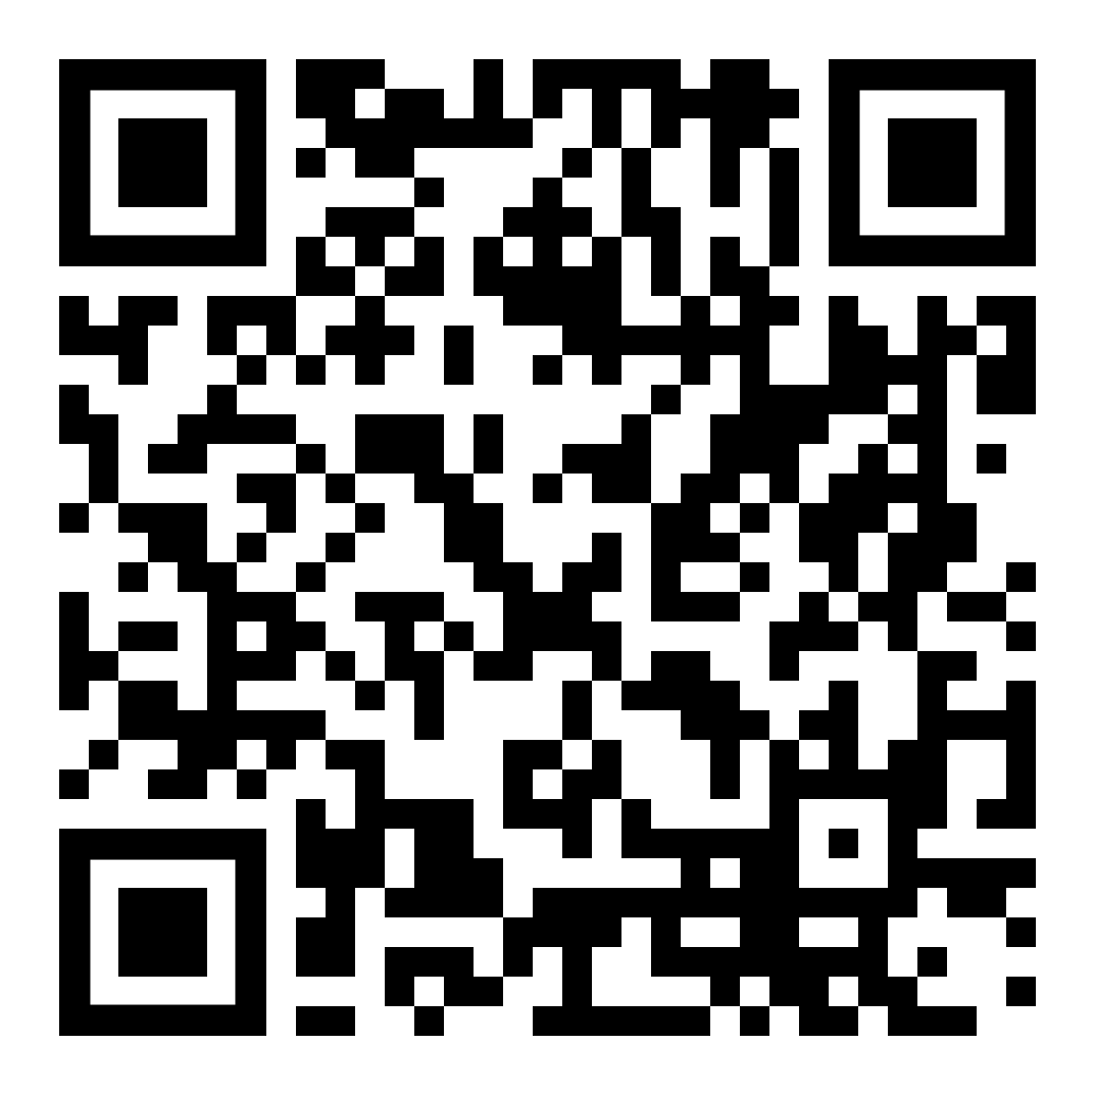
The first page of the survey asks for our course information. Here is the information you will need:
Course Subject: (Insert your 4 Letter Course Subject Identifier, ex COMM, BIOL, etc.)
Course Number: (Insert your 4 Number Course Identifier, ex 1010, 2025, etc.)
Course Section: (Insert your course section identifier, ex. D01, N07, etc.)

Slide 3
